Slide 1
Software Lifecycle Models
Chapter 2

Slide 2
Software Development Lifecycle Models
A lifecycle model provides / describes recommendations to be followed for building software-based systems.
A lifecycle model describes the activities that are performed by software development team during the project’s lifecycle.
The goals of any lifecycle model is the successful delivery of a complete, correct, and useful system to the client and users.
There have been many software development lifecycle models published over the years.
Most are variations on the Generic Waterfall Model we will be describing next.
Notes:
Emphasis that these are definitions!
Process is defined by its activities.
Process defines the order the activities are executed in.
Activities produce work products.
Work products are typically managed documents.
Each marks important milestones or results of an effort.
The are kept on protected shared file servers (not on a user’s desktop).
The are often versioned controlled.
Some work products are deliverables, others not.
Question: Example of a work product that is not a deliverable?

Slide 3
The Generic Waterfall Model is Divided into Phases
Each phase is given a name that suggest its purpose.
Phases are executed in a specific order by members of the development team.
These are the six generic phases in most lifecycle models…
Requirements Gathering
Requirements Analysis
Software Design
Implementation
Integration Testing
Delivery

Slide 4
Each Phase has a purpose that leads to the successful project delivery
Phases | Purpose
Requirements | Understanding the system’s goals, requirements, and restrictions as provided by the customer.
Analysis | Developing a sufficiently deep understanding of the system’ domain (objects, operations, workflows) to allow the design of the system’s software (and hardware).
Design | Identifying the classes, interfaces, databases, communication, algorithms and other aspects of the system design in sufficient detail to allow constructing the system’s software.
Implementation | Building (coding) the classes, databases, interfaces, and other components of the system. Integrating individual efforts into a functioning whole.
Integration Testing | Identify Faults and Incorrect Features missed by Developers.
Delivery | Install, Operate, and Maintain the System.

Slide 5
Each Phase recommends one or more Activities to be Performed by the Development Team
Activity is the generic name given to the tasks recommended by the model to be performed during each phase of the lifecycle model.
Phases | Example Activities
Requirements | Requirements engineering & Use Case Development
Analysis | Build UML Analysis Models that describe the Problem Domain
Design | Build UML Design Models that describe the Software Design
Implementation | Code and unit-test System Classes & Components
Integration Testing | Test the Executable System against Requirements
Delivery | Deliver System to Client / Make System available to users¹
Notes:
1. DevOps is a model that has the development team responsible for both building and operating the system. Common with cloud services deployment e.g. AWS.

Slide 6
Performing an Activity results in the Team producing Artifacts
Each Activity produces a unique type of Artifact:
Requirements Documents, Use Cases, UML Analysis and Design Models, Database Schema, User Interface (GUI) Mockups, Code, Executables, HTML & CSS, Integration Tests, etc.
The artifacts produced by the development team are defined by the activity they are currently executing.

Slide 7
Artifacts are used as inputs to later Activities during the Execution of a Lifecycle Model
The activity defines / describes the artifacts to be produced.
Describes the purpose of the artifact in the overall lifecycle.
The document formats, types of diagrams, level of detail, others.
The lifecycle model describes how the artifacts produced by an activity serve as the inputs to the activities that follow.
Subject Matter Experts
Requirements
Formal Requirements / Use Cases Documents
Analysis
UML Models describing Problem Domain
Design
Software / Databases Designs / etc.
Implementation
Executable System
Integration Testing

Slide 8
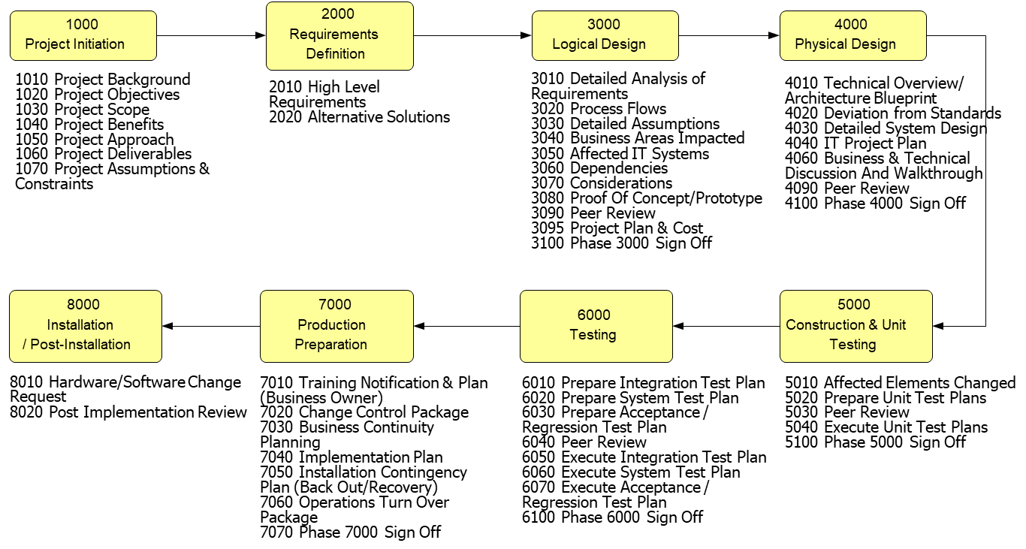
Example of Activities in a Software Development Process
Notes:
This is a process based on the waterfall model.
It is a process because it is a precise description of the phases with the activities executed and artifacts produced during each phase.
It is waterfall because the team is expected to execute the process linearly, with each phase completed before the next phase started.

Slide 9
Three Common Lifecycle Model Categories Prescriptive Models
Prescriptive models describe (prescribe) in detail the Activities and Artifacts the development team produces at every phase in the process.
Prescriptive software development is based on the traditional, top-down management of the project lifecycle.
Prescriptive models emphasizes management’s monitoring and control of the project’s execution by the development team.
Some processes based on prescriptive have phases that are executed sequentially and in a single pass.
A Waterfall-based process has each phase executed to completion before the next phase begins.
Notes:
Waterfall.

Slide 10
Three Common Lifecycle Models Incremental (Iterative) Models
Incremental models share many of the characteristics of prescriptive models.
They describe activities and artifacts the team should execute.
Incremental models allow the system to develop incrementally over the project lifecycle.
Incremental models emphasize cycles (iterations) that include design / code / test for each feature to be delivered.
Incremental models allow the team to develop the system’s requirements and design incrementally over time.
Notes:
Unified Process - Incremental development
Spiral development
Continuous integration
Note that a specific process can have properties of both models i.e. Unified Process is both prescriptive and incremental.

Slide 11
Three Common Lifecycle Models Agile Models
Agile models eliminate the time and cost of producing and maintaining the artifacts (documents) mandated by a prescriptive process.
A process based on the Agile model (Scrum) is free of mandated activities and rigid controls.
Agile models rely on the development team self-organizing and taking responsibility for the project’s success free from burdensome oversight.
Notes:
Scrum an agile, incremental process so is much less prescriptive
Extreme Programming - Agile development.
DevOps – Team is responsible for both development and operations of a system.

Slide 12
Qualities of Prescriptive & Incremental Models
Both Prescriptive and Incremental Models describe a development process that guides the construction of software-based systems.
A Process based on these models describes a distinct set of activities executed during each phase.
The order in which the activities are executed (the workflow).
The input and output artifacts (work products) for each activity.
These models also provides the development team a set of Umbrella Activities used to monitor and manage the project’s execution i.e., scheduling, documentation, testing, others.

Slide 13
Qualities of Agile Models
A processes based on the Agile Model recommends few activities and artifacts for the dev team to execute.
Agile Processes eliminates the overhead of creating and maintaining documents and other artifacts required by a Prescriptive Process.
An Agile Process relies on the team to self-organize the activities needed to complete the project.
An agile process requires the team to take responsible for delivering a complete and correct system.
We will be covering Agile Processes in a future section.

Slide 14
Historical Perspective
Prescriptive was the first development processes to be practiced by the software development community.
Prescriptive software development models go back 50 years.
Prescriptive models were based on existing project management techniques originally used in manufacturing and construction.
Prescriptive models were invented to address software development problems of the past and still today…
The lack of understanding of the problem domain produces systems with incorrectly implemented and missing features.
The lack of design produces software of poor quality i.e., that are unreliable, difficult to understand, and difficult to extend.
The lack of monitoring and metrics (measurements) results in projects that are difficult to manage and are delivered late and over budget.

Slide 15
The Waterfall Process
The Waterfall Process is based on the Prescriptive Model.
Waterfall Process strongest characteristic is that each of its phases is executed only once.
The result of this single pass through the phases activities is expected to be a complete and correct system.
Subject Matter Experts
Requirements
Formal Requirements / Use Cases Documents
Analysis
UML Models describing Problem Domain
Design
Software / Databases Designs
Implementation
Executable System
Integration Testing
Notes:
Mention Royce paper in Supplemental Materials.
Each activity delivers the work products needed by the next activity.
Waterfall process has been shown not to work many times.
Why: Because it does not adapt to changes in the customer’s needs.
Why: Because by its very nature, the development team must understand the requirements before beginning the planning stage.
Very few examples exist where the waterfall model works.
Example: If the team believes that the requirements can be full understood before planning begins and the rest falls into place.
For example, If the organization produces the same type of system.

Slide 16
Arguments Supporting Waterfall Processes
Waterfall bring discipline to software development.
Management likes the idea of planning and scheduling the project deliverables i.e., knowing when to expect delivery and the cost of producing the system.
Waterfall requires a detailed recording of the requirements, analysis and design models.
Besides development, these documents have value as management, maintenance, testing, and training materials.
Producing 100% correct requirements and design artifacts is a worthy goal.
The effort put into perfecting requirements, analysis, and design ‘seems’ professional and in-line with disciplined engineering.

Slide 17
Argument Against Waterfall Processes
Waterfall stipulates that each phase be executed once.
The dev team gets a single opportunity to get each phase right.
Waterfall requires that the artifacts produced at each lifecycle phase be 100% correct before moving to the next phase.
For example, having completed and correct requirements is fundamental to waterfall-based process.
Once finished, requirements should not be changed (but they are).
Although 100% correct and complete coverage is a worthy goal, the reality is that correctly and completely capturing a system’s requirements, analysis, and design at the project’s start is very difficult and very expensive (if not impossible).

Slide 18
The Difficulties of Requirements Gathering Activities
A system of medium to large complexity can have thousands of requirements to document and manage.
Imagine identifying missing, duplicate, or conflicting individual requirements among thousands of requirements.
The SME is often unable to correctly identify all the requirements.
SME forgets about, or is ignorant of, important details concerning the system’s operation.
SME provides information they consider correct but is incorrect.
SME is unable to imagine, or neglects to mention, the system’s responses to all possible operating conditions often ignoring problems or errors that occur during system’s operations.
Customers wish to change or add additional features to the system after the requirements phase activities has been completed.
And it’s impossible to refuse the customer’s request.
Notes:
SME : Subject Matter Expert

Slide 19
Waterfall Processes are Difficult to Execute
Organizations lack the resources and skills to complete the requirements and design efforts correctly.
Resources: Fully documenting every aspect of a complex system can require hundreds of man-hours producing and reviewing detailed documents / artifacts.
Skill: Only a system architect with remarkable skills and deep understanding of the problem domain can produce the complete and detailed system design required by this one-pass approach.
Unfortunately, architectural gods are in short supply.
Most engineers will have difficulty producing designs for systems of even modest size and complexity in a single pass.

Slide 20
Other Arguments Against Waterfall Process
Waterfall does not recognize the need to accommodate changes in the system’s requirements after the requirements phase ends.
Error in requirements tend to be caught late in the project lifecycle where they are most expensive to fix i.e., during construction or integration testing.
Waterfall formally delays system integration until late in the project lifecycle where problems are the most expensive to fix.
Waterfall does not recognize the benefits of integration testing of the system throughout the project lifecycle.
Customer must be patient to see what they are buying as the system is delivered late in the project lifecycle.

Slide 21
Winburg Case Study
The book references a case study describing the problems experienced during development of a system.
A system whose final delivery required the release of four versions.
Releases 2-4 corrected performance, accuracy problems, and required changes required in previous releases.
The case study’s take-away are that:
Releases 2-4 are modifications / extensions of the previous release.
Each release reflects a refinement of both the developers and customers understanding of the problem domain.
The developers and customers needed to experience each release to appreciate the problem domain and understand their needs.
Is there a software development process that promotes this incremental approach of building systems?

Slide 22
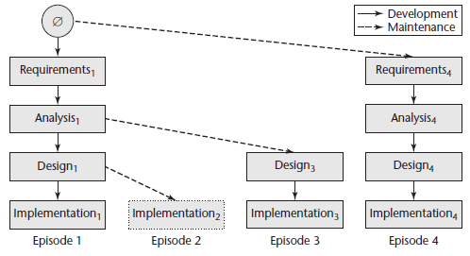
Evolution Tree Lifecycle Model
The study’s project transitions through four partial passes of the generic lifecycle phases across four versions (iterations).
Each release reflecting gained understanding of the problem domain.
The system is evolving with each release with an increased understanding of the problem domain and client requirements.

Slide 23
“Waterfall with Feedback” Lifecycle Model
The book describes a waterfall model that permits returning to previous phases to correct problems with the artifacts.
See next slide.
This model suggests that for every return to a previous phase, the team updates the documents and other artifacts.
Waterfall with Feedback Advantages are:
This lifecycle model recognizes that the team will discover new requirements and better ways to design the system as their understanding of the problem domain improves.
The model recognizes that mistakes will be made early in the lifecycle and must be corrected as they are discovered.
The model emphasizes the importance of documentation.
Notes:
Each activity delivers the work products needed by the next activity.
Waterfall process has been shown not to work many times.
Why: Because it does not adapt to changes in the customer’s needs.
Why: Because by its very nature, the development team must understand the requirements before beginning the design and implementation.
Very few examples exist where the waterfall model works.
Example: If the team believes that the requirements can be full understood before planning begins and the rest falls into place.
For example, If the organization produces the same type of system.

Slide 24
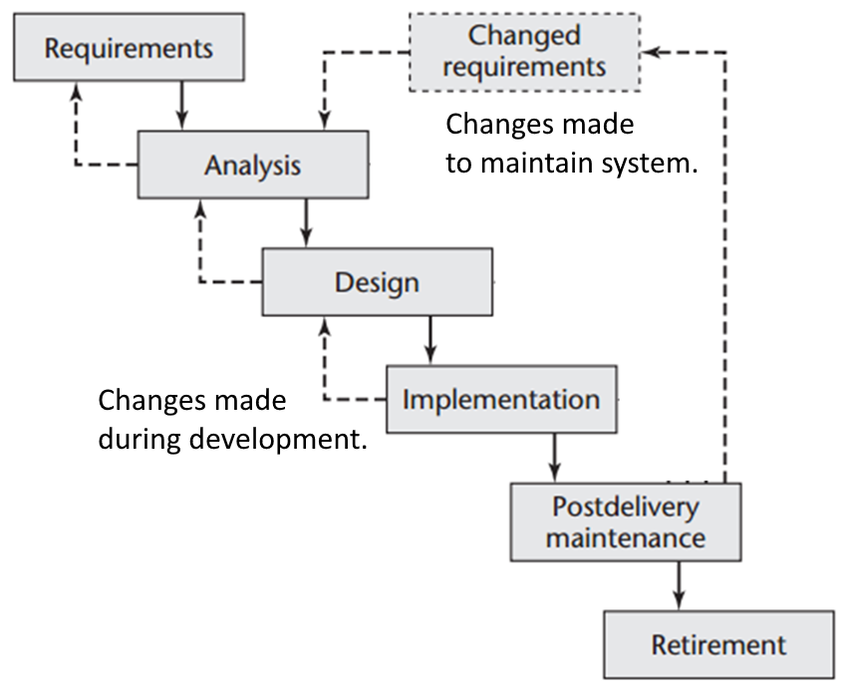
“Waterfall with Feedback” Lifecycle Model
In many ways the cycles in this model resemble the Iterative approach to software development described next.
Notes:
This is process is very similar to one suggested by Royce in his 1970 paper.

Slide 25
Iterative / Incremental Development
The issues described by the Winburg case study are common.
Each release of the system contained a new flaw / issue to be addressed.
Eventually arriving at a stable release but taking 4 releases.
Each release produced an evolved version of the system.
Each release was made in response to an improved understanding of the problem domain and system requirements.
The system was developed incrementally to meet the customer’s evolving requirements.
Recognizing that evolutionary development is inevitable, we should embrace an iterative and incremental lifecycle model.

Slide 26
Can the requirements be completely and correctly captured at the project’s start?
One restriction of a waterfall model is that we should fully capture the system’s requirements before starting analysis.
However, the team has the least understanding of the project and its problem domain at the project’ start.
This makes it difficult (impossible) to completely and correctly capture the system’s requirements in a single pass.
An incremental approach to development allows developers to incrementally analyze, design, code, and test the system.
Allowing teams to implement ‘slices’ of the system, one after another, until the system is complete.
Allowing teams to start with more easily understood features progressing towards more complex features.

Slide 27
The Reality of Software Development
Ideally, the team follows a waterfall process applying the phases of their process resulting in a complete and correct system.
Unfortunately, this approach seldom works as desired.
The team produces incorrect and incomplete requirements.
The client’s requirements change during the project.
The development team makes mistakes.
They miss-interpret the requirements resulting in incorrect features.
There are problems with the system’s design that must be reworked.
We can’t eliminate these problems, but we can minimize their negative effects on the project’s outcome.
Incremental Software Development Models attempt to minimize the effects of these problems.

Slide 28
Incremental Software Development
The incremental software development model minimizes the damage caused by errors and changing system requirements.
This is accomplished by:
Recognizing that a system cannot be completely understood before construction begins.
Recognizing that inevitable bugs and flaws in the design must be identified and addressed as soon as possible in the project.
Recognizing that the system’s design will evolve as the team gains through experience, a better understanding of the problem domain and requirements.
Recognizing that the client’s requirements will change before the system is delivered.
Notes:
1. Not waiting until the problems are uncovered during integration testing.

Slide 29
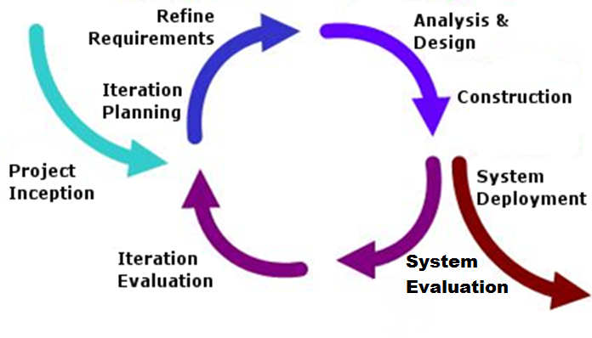
An Incremental Model applies the Waterfall Phases and Activities in an Incremental Fashion
“Design a Little, Code a Little, Test a Little”

Slide 30
Incremental Model
The characteristics of the Incremental Model are…
The system is constructed incrementally in stages called Iterations.
Each iteration begins by selecting some ‘slice’ of functionality (features) that remains to be implemented. These features are completed during the iteration.
An iteration begins with a refinement activity that refines the requirements, analysis, and design of only the selected features.
During the iteration, the team completely implements the iteration’s selected features.
The iteration ends with an opportunity for the SME/client to evaluate the evolving system and make recommendations.

Slide 31
Incremental Model
Conclusion of each iteration allows…
Each iteration delivers a partially completed system that provides additional functionality over the previous iteration’s delivery.
Each iteration provides the developers the opportunity to evolve the system’s design as the team’s understanding of the problem domain improves.
Each iteration provides the developers the opportunity to evolve their software development process for the given project.

Slide 32
Problems are Identified at each Iteration’s End
The System Evaluation activity at the iteration’s end allows the customer to identify errors and changes early in the project lifecycle¹ .
Compared with the waterfall process where (in theory) the system is not evaluated until project end during the Integration Testing phase.
Errors and Changes brought on when:
Mistakes or omissions are made by the SME i.e. requirements.
Incorrect assumptions are made by the development team because of vaguely defined requirements.
Bugs and mistakes in the implementation.
Changes in the business environment causes a change in the system’s requirements.
The experience of completing each iteration provides the developers a better understanding of problem domain and an opportunity to improve the system’s design.
Notes:
1. Compared with the waterfall process where (in theory but seldom practice) the system is evaluated as a whole at the end of the project lifecycle during the Integration Testing phase.

Slide 33
Incremental Model Mitigates Risk
Risks are features whose implementation is not understood or requirements that it may not be possible to meet.
For example, the client may have requirement for a Transactions Per Minute (TPM). It is important to know ASAP whether the system’s design can sustain the required transaction rate.
There may be features whose implementation is not understood by the team and would benefit from a “Proof of Concept” prototype.
Identify risky features early in the project’s execution.
Address risky features in early iterations of the project.
Minimize the effects of changes and redesign to the system needed to accommodate risky features.

Slide 34
Incremental Model Provide Multiple Opportunities to Validate the System
Incremental models provides multiple opportunities to validate the system’s design and implementation.
The customer has access to the system for evaluation at the end of each iteration i.e. at System Evaluation.
The team tests the system at the end of each iteration e.g. executes the suite of unit tests built up from this and previous iterations.
Non-functional requirements can be verified as early as possible in the project lifecycle.
For example, performance or reliability requirements can be tested with appropriate tools.

Slide 35
Incremental Models Minimizes Expensive Change
Incremental development allows us to identify problems with the system’s basic design (architecture) early in the project lifecycle.
Architecture is the basic design that determines how system components are integrated together and communicate.
As we incrementally add new features to the evolving system, we evaluate whether the design will meet the requirements.
Will the design scale to increase performance over time?
Will the design accommodate security and privacy requirements?

